Slide 1

Intelligent Eye

Slide 2












Meet Our Team
Mostafa Nader
Yasmeen
Ibrahem Abd Elrahman

Slide 3

يا ابن آدم ،إنما أنت أيام ، فإذا ذهب يومك ذهب بعضك ، ويوشك إذا ذهب بعضك أن يذهب كلك .
البصري الحسن

Slide 4








Content
Problem Statement
models overview
Objectives
implementation
Demo
Future Work
Conclusion
Project Idea

Slide 5

Problem Statement

Slide 6

In Jun 2023
More Than 12 Million
Have Some Sort Of Visual Impairment

Slide 7
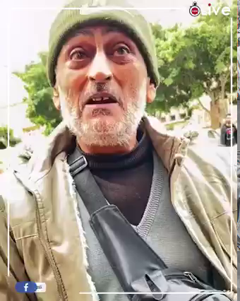

Slide 8
Project Idea

Slide 9
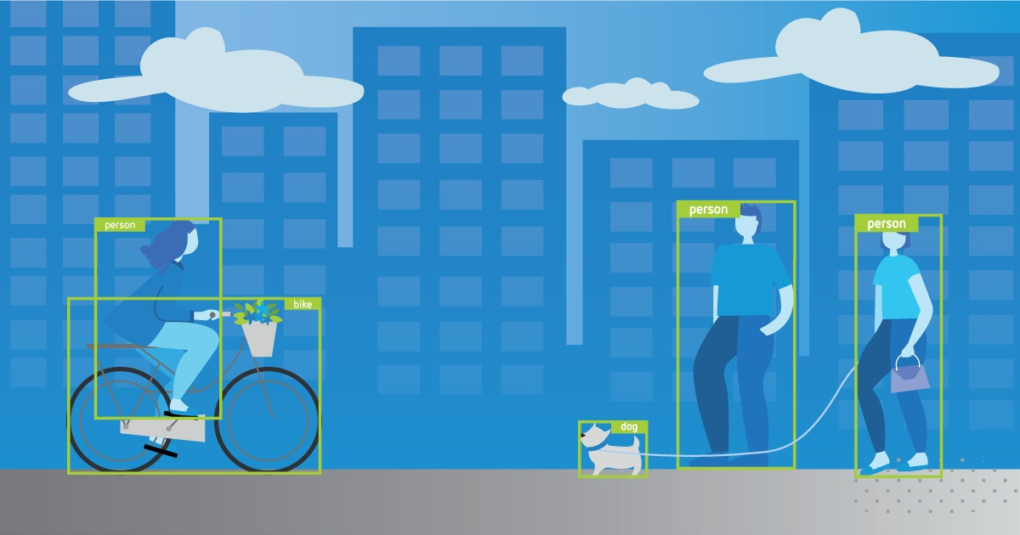
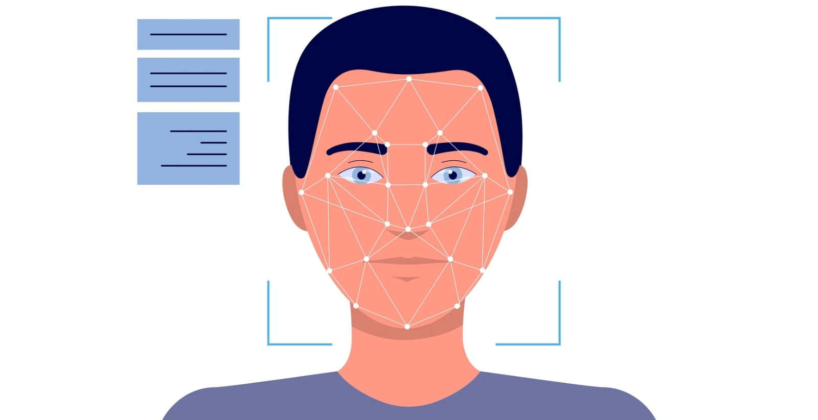

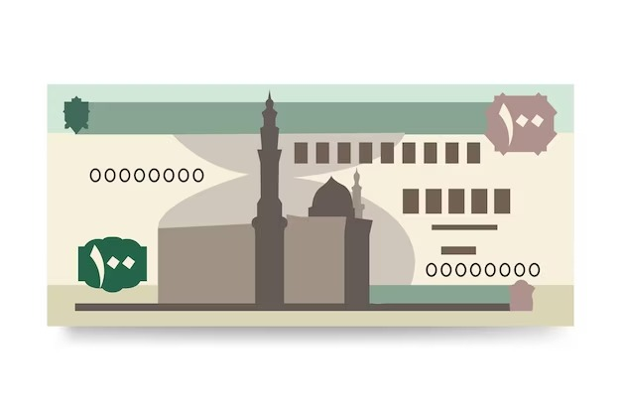
Project Idea
1
4
2
3
Object Detection
face recognition
Egyptian currency
OCR

Slide 10

Face recognition

Slide 11


Slide 12

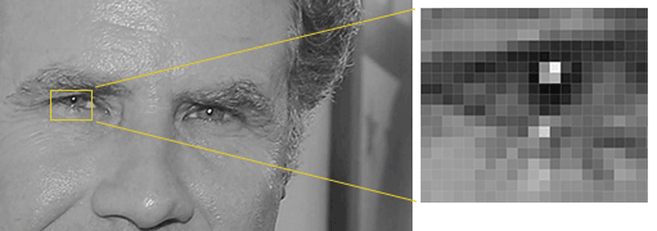

Analyze Facial Feature
HOG

Slide 13
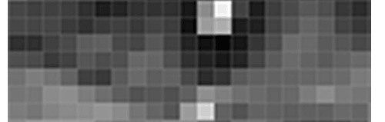
Analyze Facial Feature
HOG

Slide 14
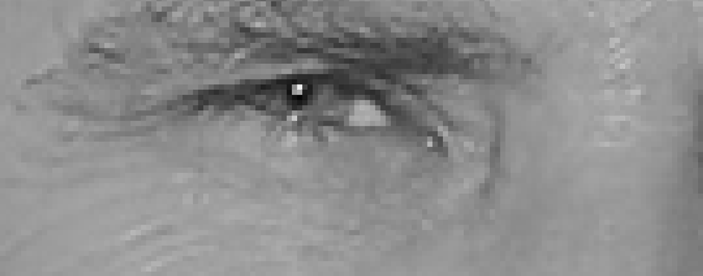
Analyze Facial Feature
HOG

Slide 15
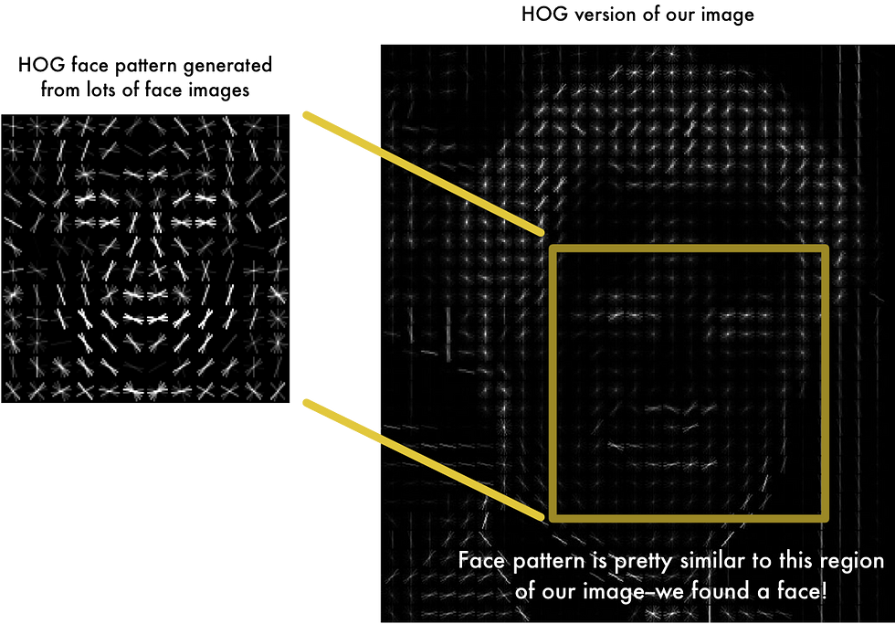
Analyze Facial Feature
HOG

Slide 16
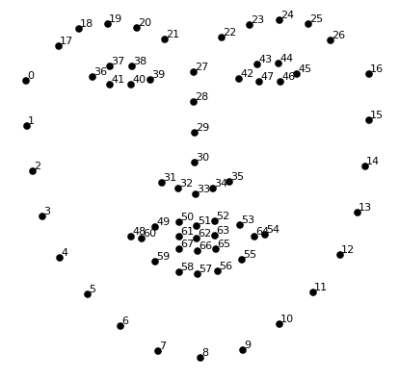
Analyze Facial Feature
HOG

Slide 17
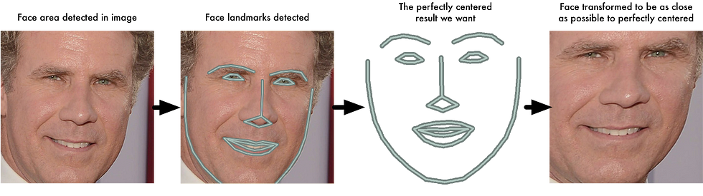
Analyze Facial Feature
HOG

Slide 18
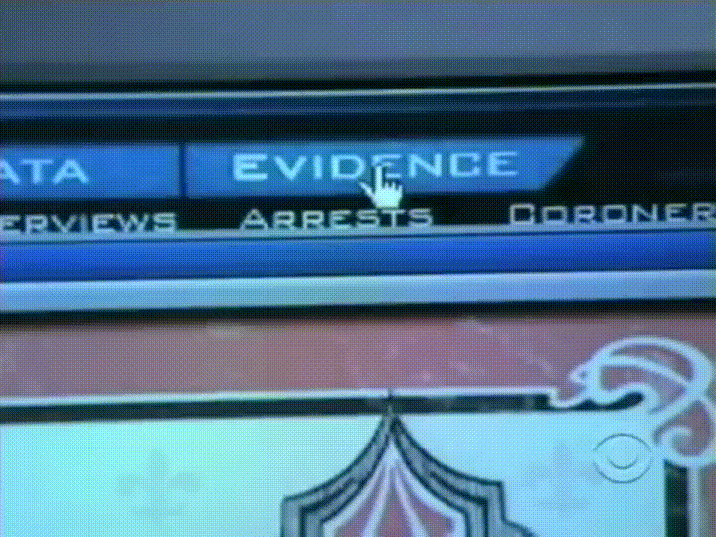
Analyze Facial Feature
HOG

Slide 19
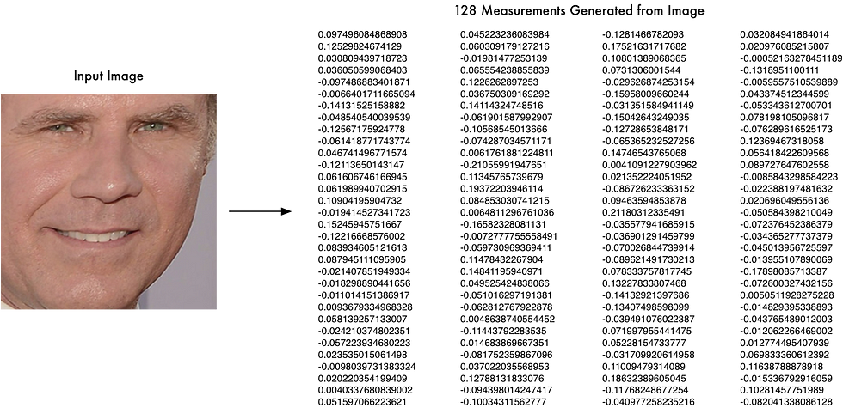
Analyze Facial Feature
HOG

Slide 20
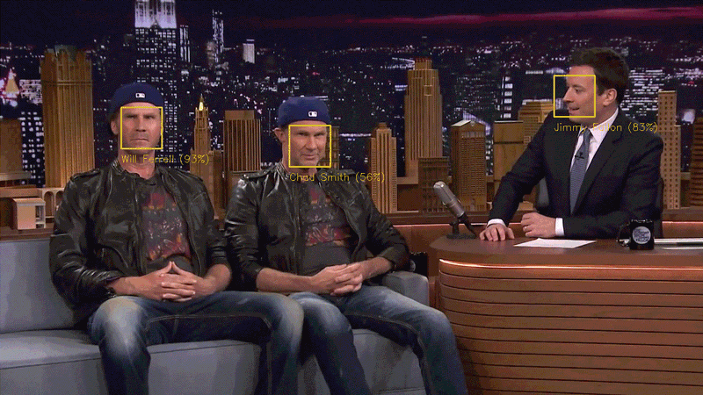
Make A Prediction

Slide 21

Egyptian Currency

Slide 22
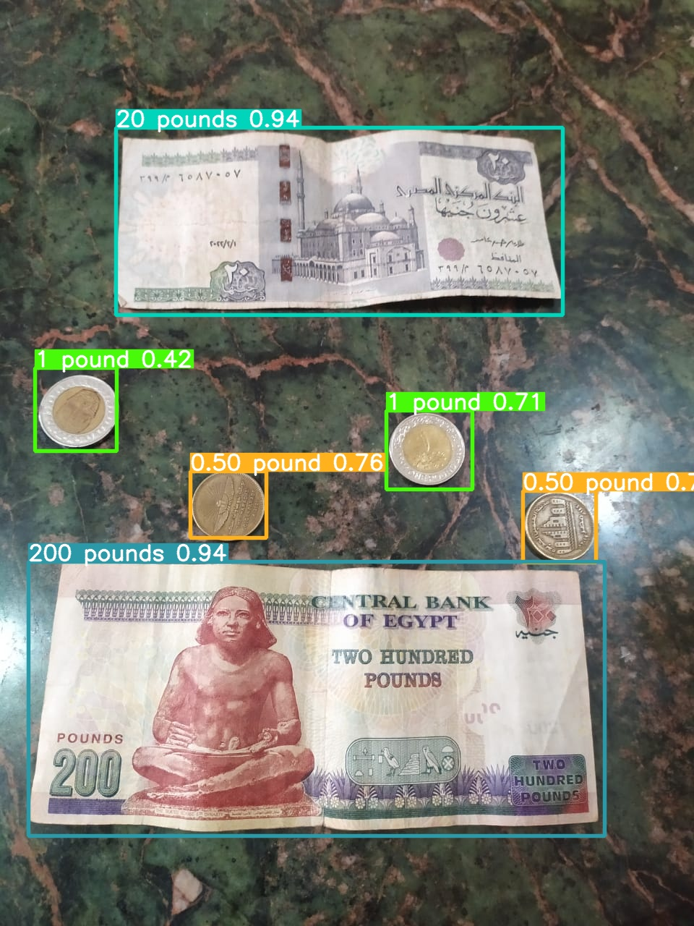
Result : 223 Pound

Slide 23
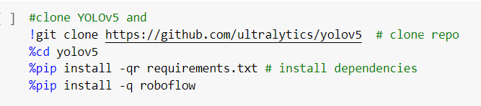
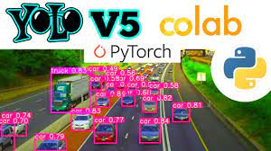
Training A Model
We can train our model following only 4 steps.
Step 1 -- clone and install YOLOv5 and its dependencies

Slide 24
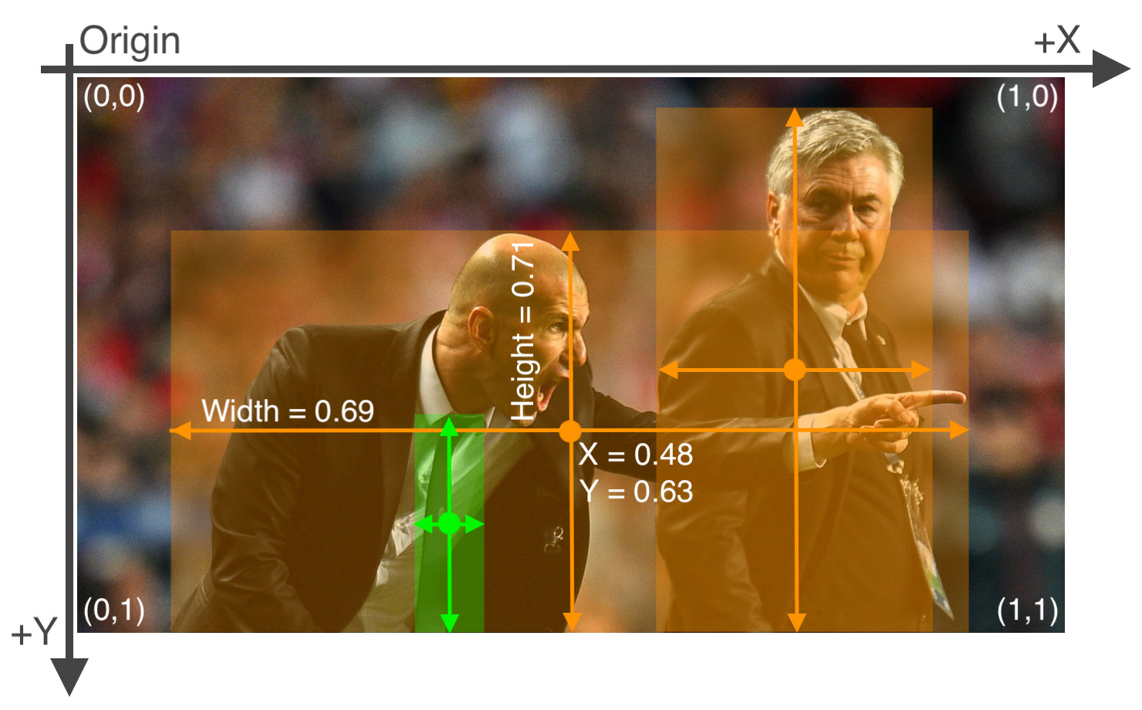
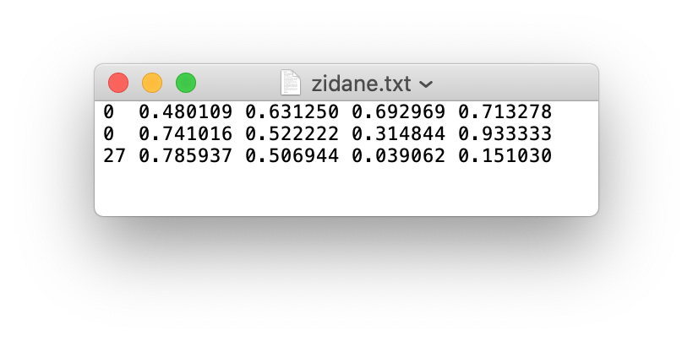
Training Yolov5 With Custom Dataset
The annotation file for the image above looks like the following:

Slide 25
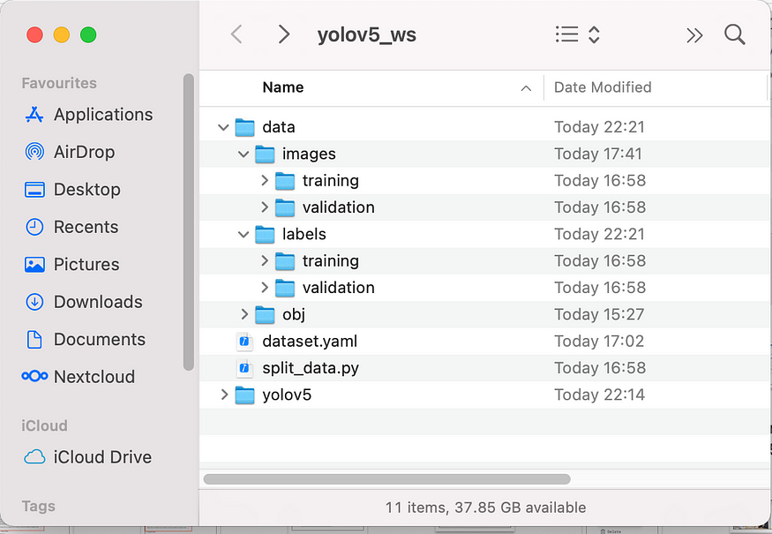
Training A Model
step--2 Getting & preparing the data Convert the Annotations into the
YOLO v5 Format as we explained in previoes slide .
in case of our data we used it from roboflow .
data looks like :-

Slide 26
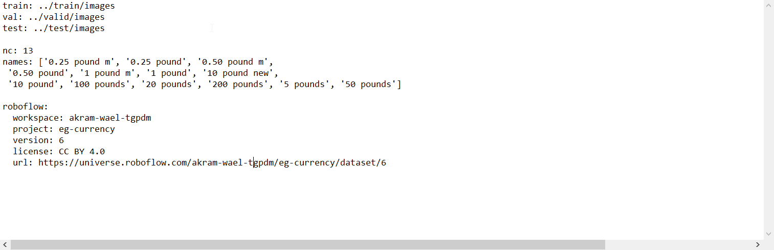
Training A Model
step 3 preparing the training configuration file : -

Slide 27
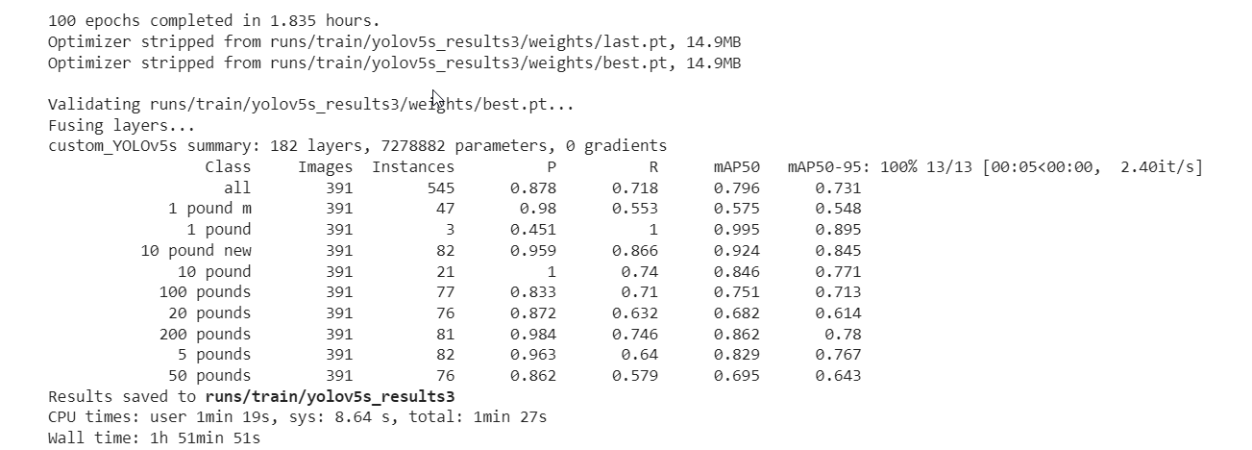
Training A Model With 100 Epochs
Step 4 — Running the train
we trained our model two times first time we got these scores for 100 epochs

Slide 28
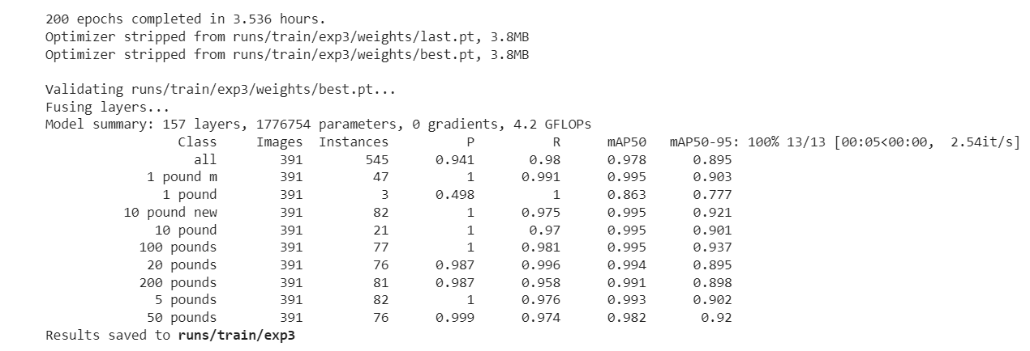
Training A Model With 200 Epochs
second time we got these scores for 200 epochs mAp getting better

Slide 29
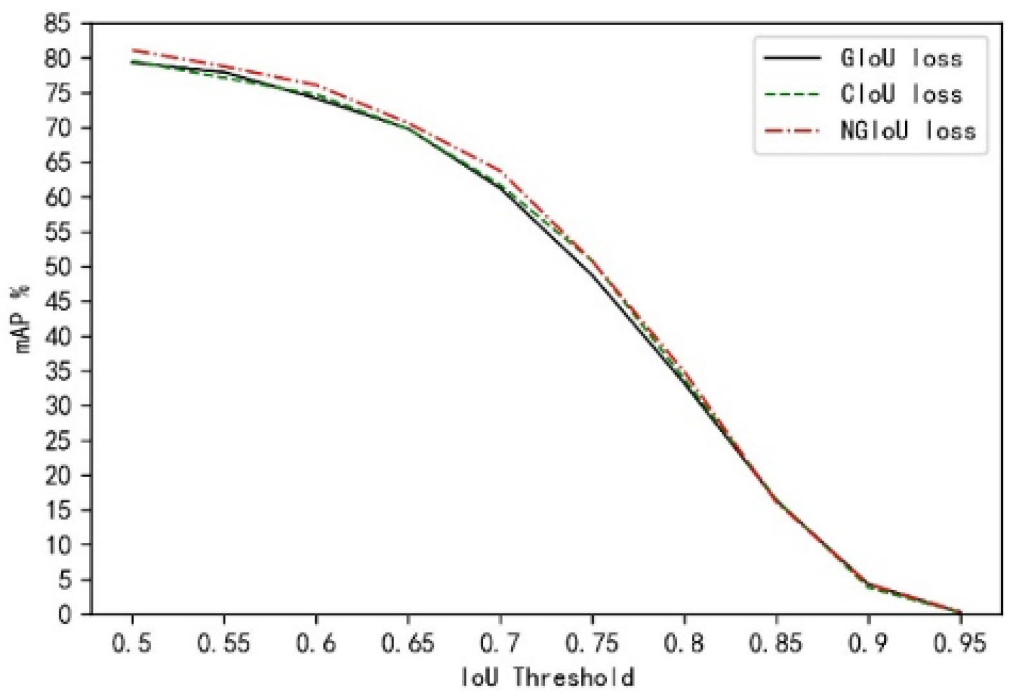
difference between MAP & MAP 0.5

Slide 30
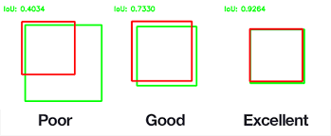
What Is (intersect over union)IOU

Slide 31
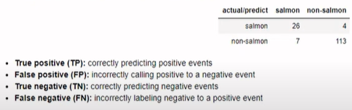
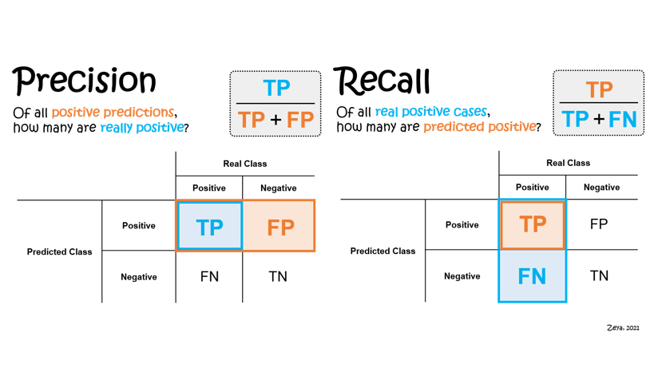
Precision & Recall

Slide 32
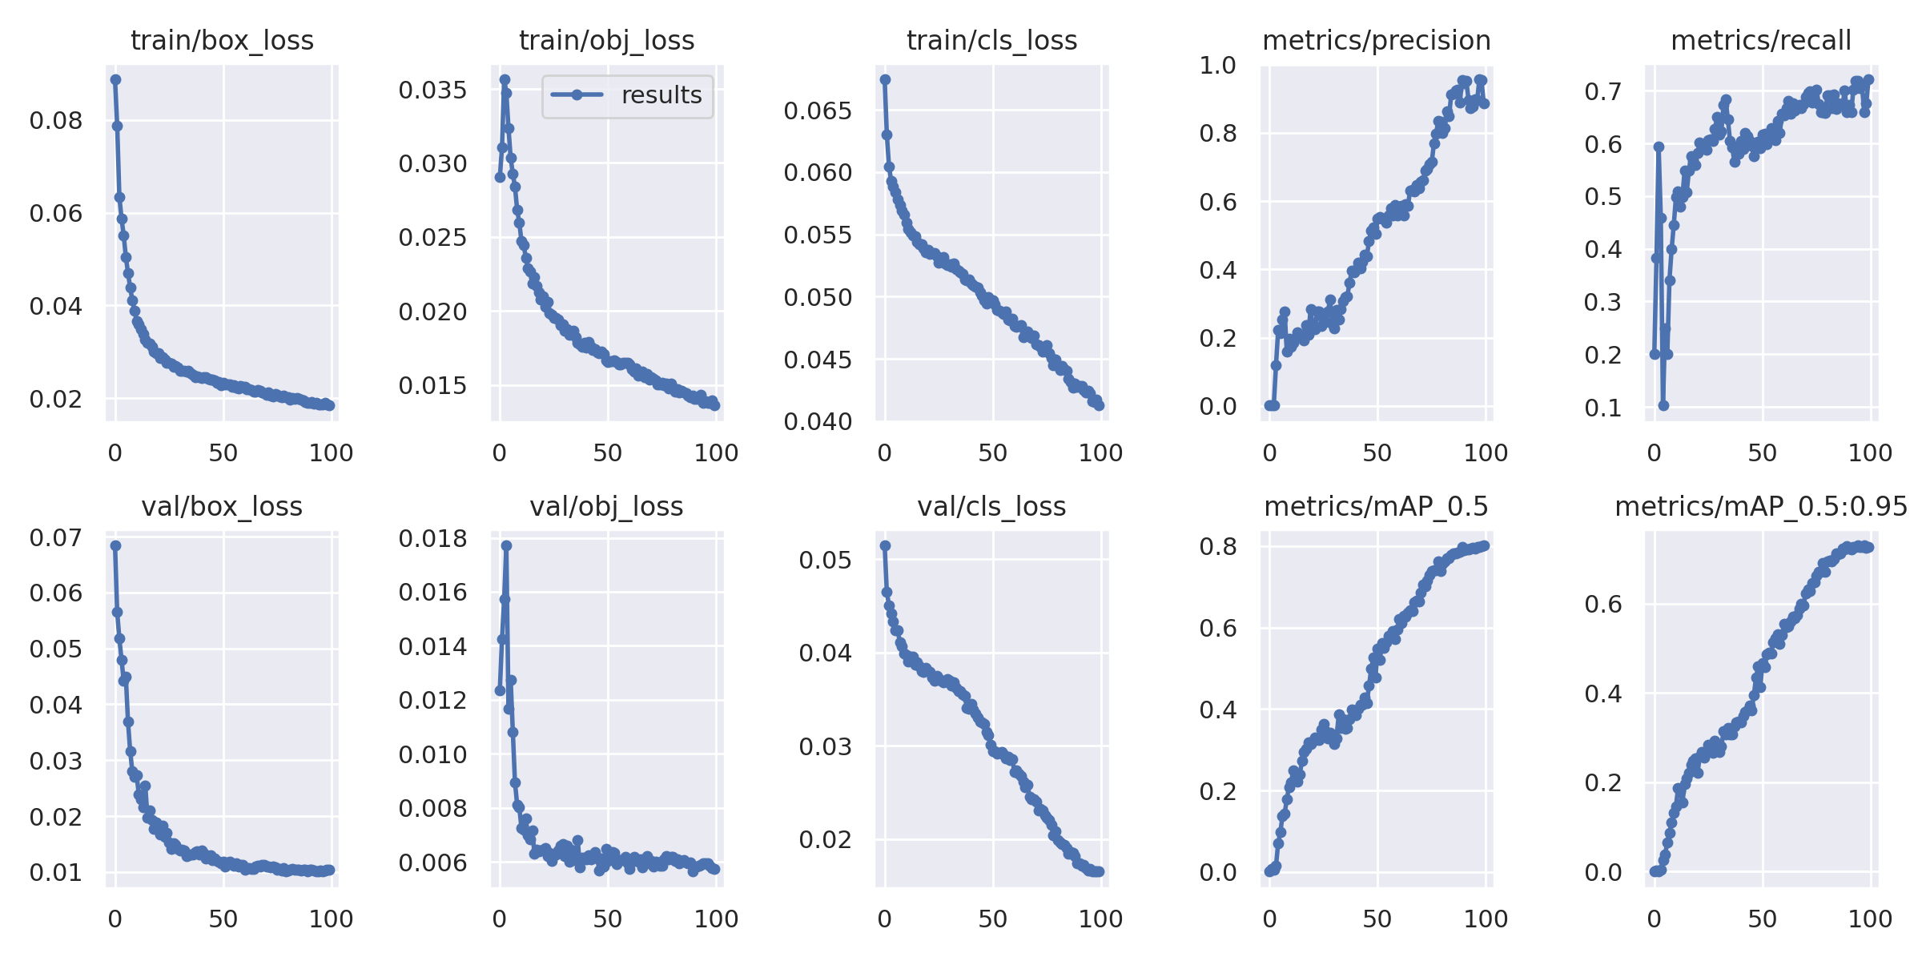
Training A Model With 100 Epochs

Slide 33
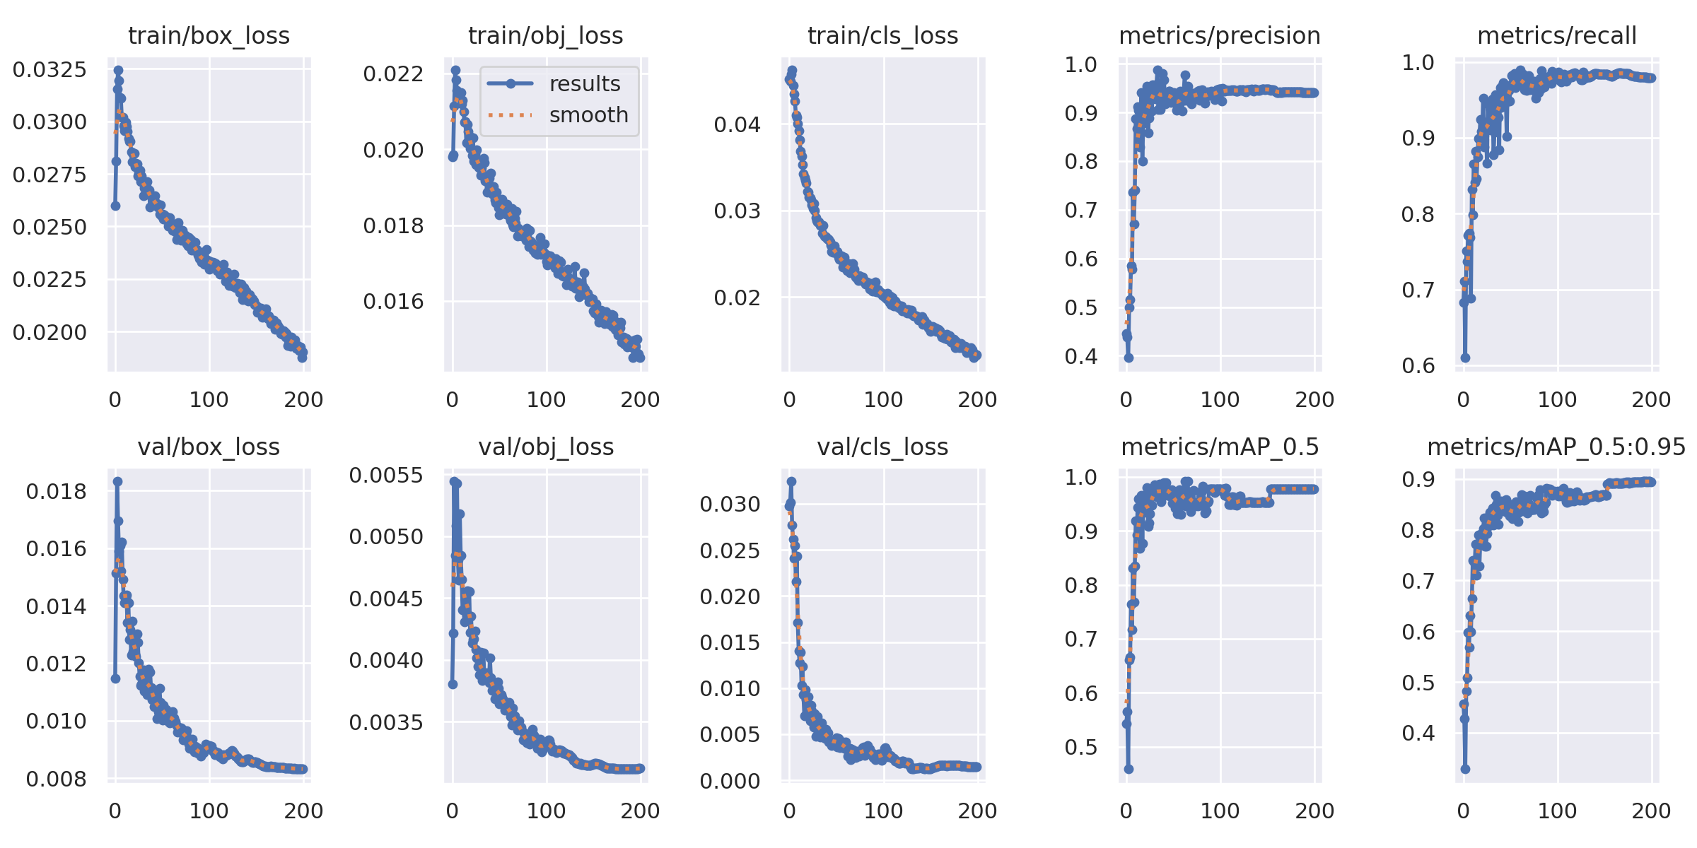
Training A Model With 200 Epochs

Slide 34
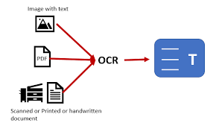
OCR

Slide 35
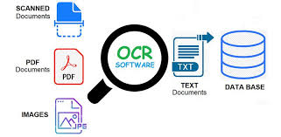
Optical Character Recognition (OCR)
What is OCR (Optical Character Recognition)?
-Optical Character Recognition (OCR) is the process that converts an image of
typed, handwritten, or printed text into a machine-readable text format

Slide 36
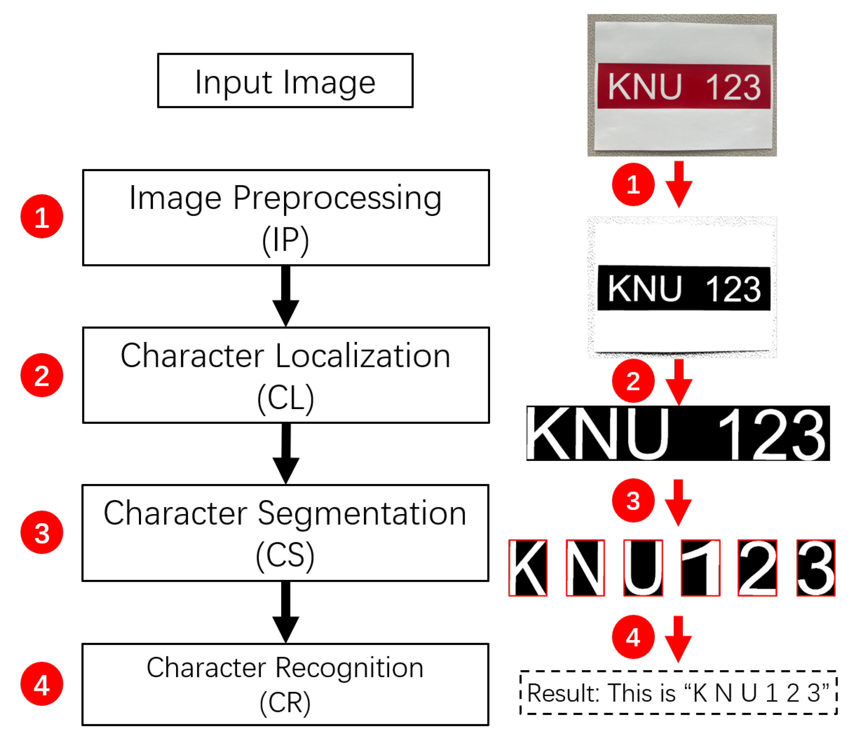
Optical Character Recognition (OCR)
How does Optical Character Recognition Work?
- Let’s have a look at three basic steps of optical character recognition:
1- image pre-processing.
2- Character recognition
3- and the post-processing of the output.

Slide 37
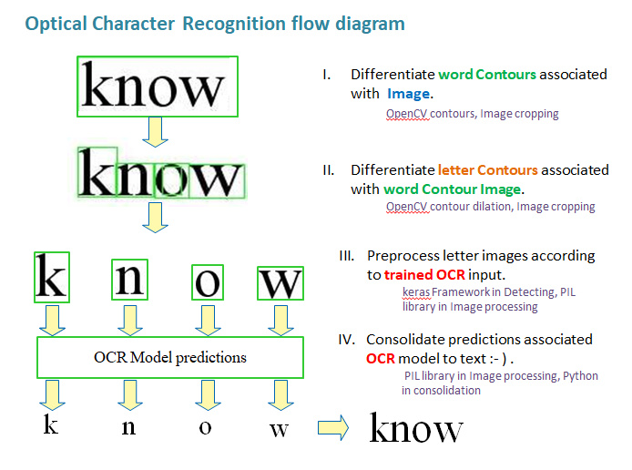
Optical character recognition (OCR)
What is OCR (Optical Character Recognition)?
-Optical Character Recognition (OCR) is the process that converts an image of
typed, handwritten, or printed text into a machine-readable text format

Slide 38
Object Detection

Slide 39
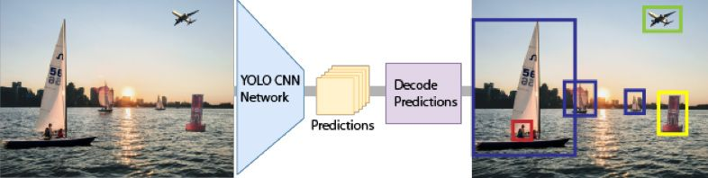
Object detection
object detection feature is used to help blind people in detecting the obstacles around them and then recognizing them using voice speech,
It deals with localizing a region of interest within an image and classifying this region like a typical image classifier, we used in our feature the YOLO(You only look once) Model which is a single-shot detector model,

Slide 40
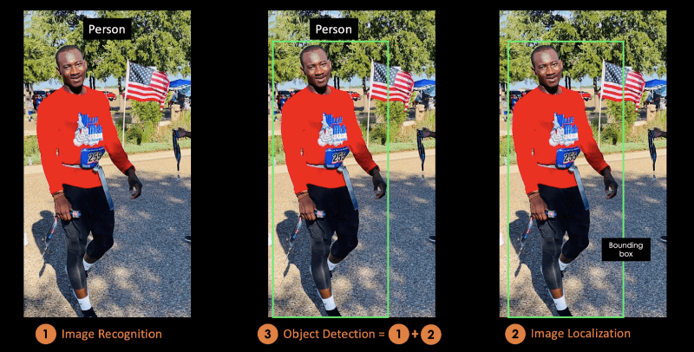
object detection using yolo
-Single-shot object detection uses a single pass of the input image to make predictions about the presence and location of objects in the image.
-It processes an entire image in a single pass, making them computationally efficient,
also its better in real time detection and thats why we used the yolo model.

Slide 41
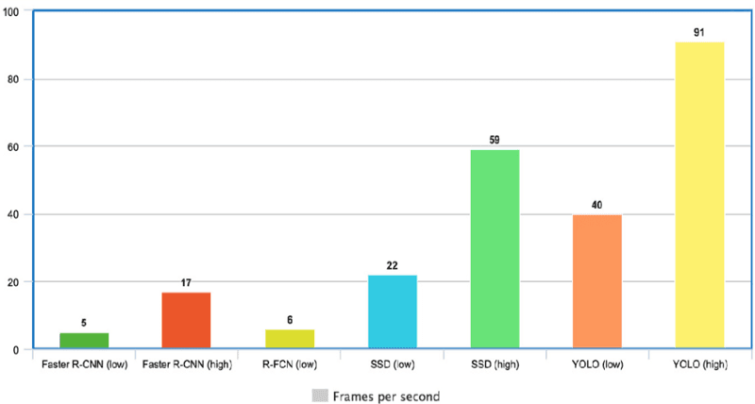
why we used yolo
-YOLO is extremely fast because it does not deal with complex pipelines. -It can process images at 45 Frames Per Second (FPS).
- In addition, YOLO reaches more than twice the mean Average Precision (mAP) compared to other real-time systems, which makes it a great candidate for real-time processing.

Slide 42
Project Objectives

Slide 43
Overall
the goal of the project :
is to develop a system that can assist blind people in their daily lives -by providing them with information about their surroundings and
-helping them complete tasks more easily.
By combining multiple features such as
1- object detection.
2- Egyptian currency detection and countingtem.
3- face recognition.
4- OCR.
Our system can provide a comprehensive solution for blind people.

Slide 44
Implementation

Slide 45

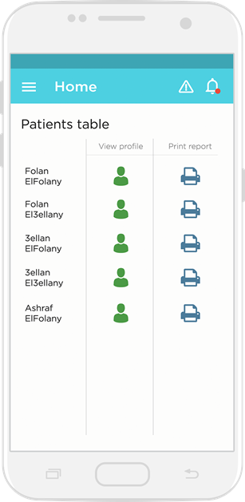
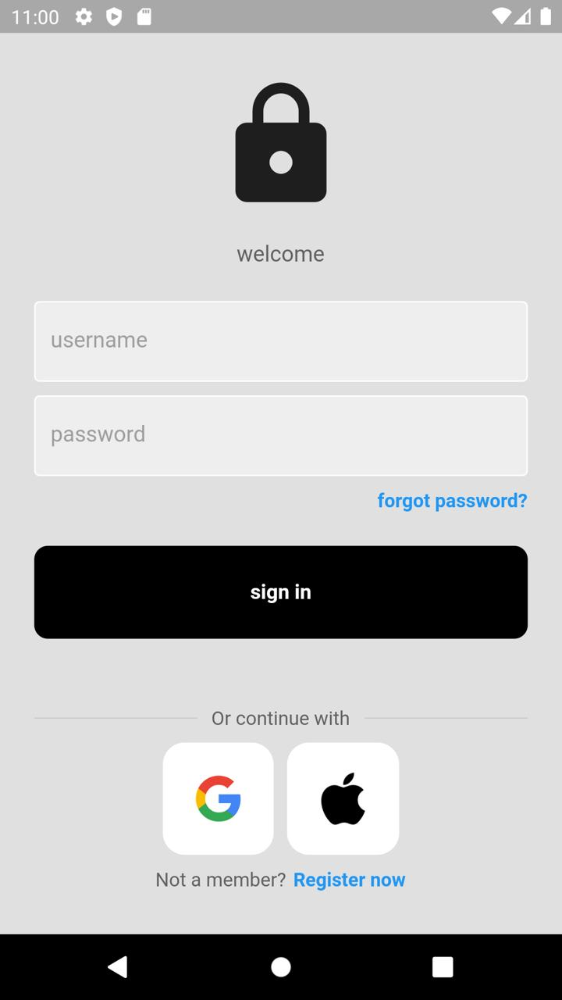
login page

Slide 46
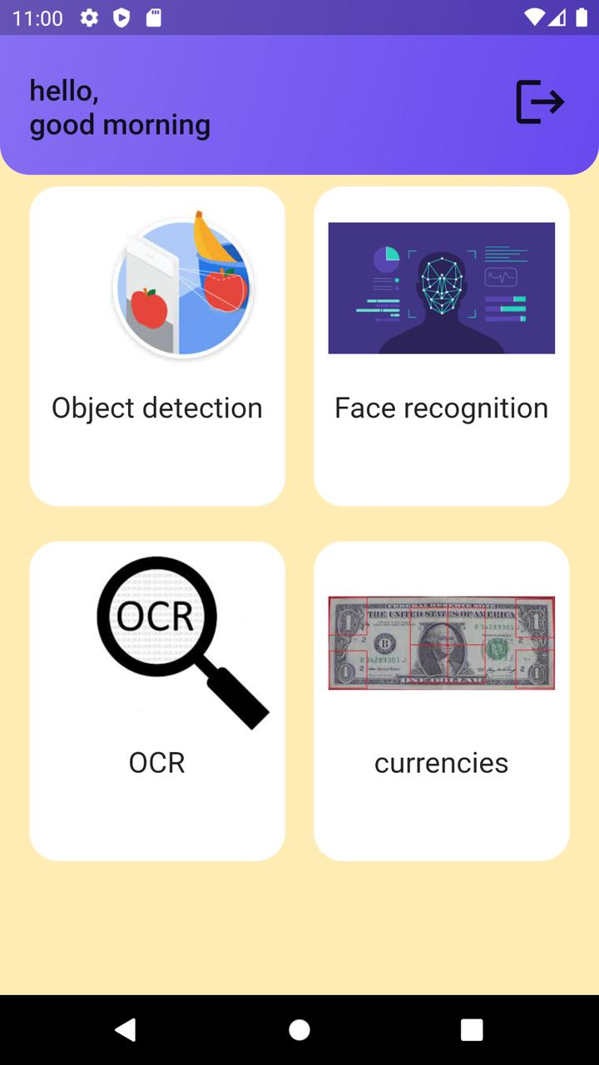
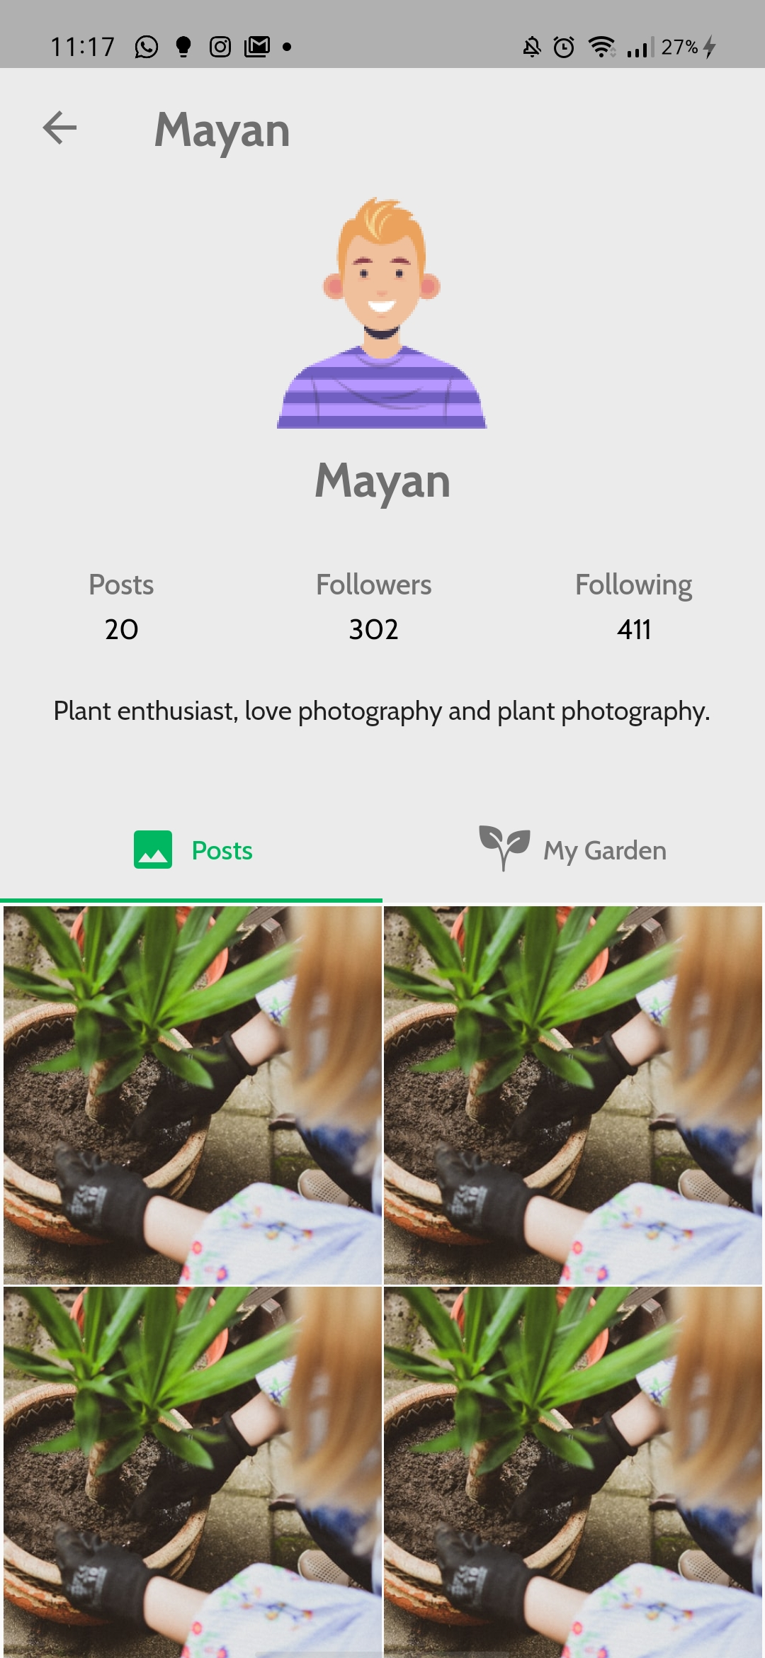

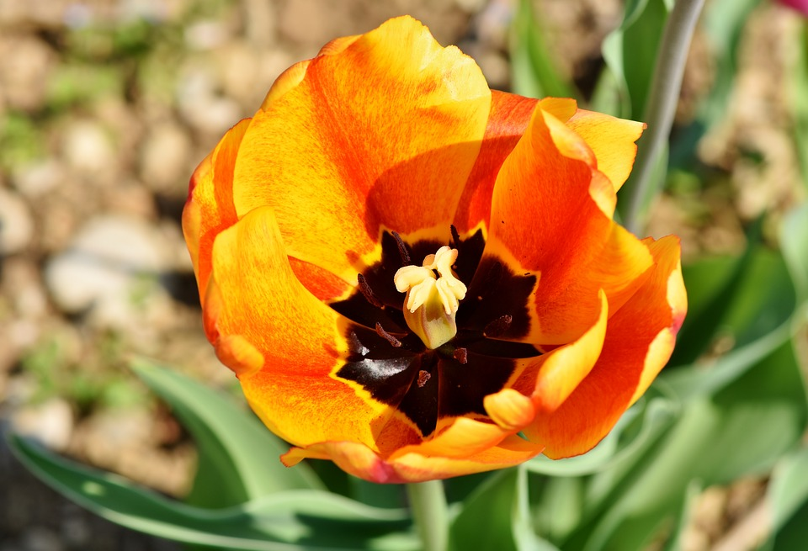
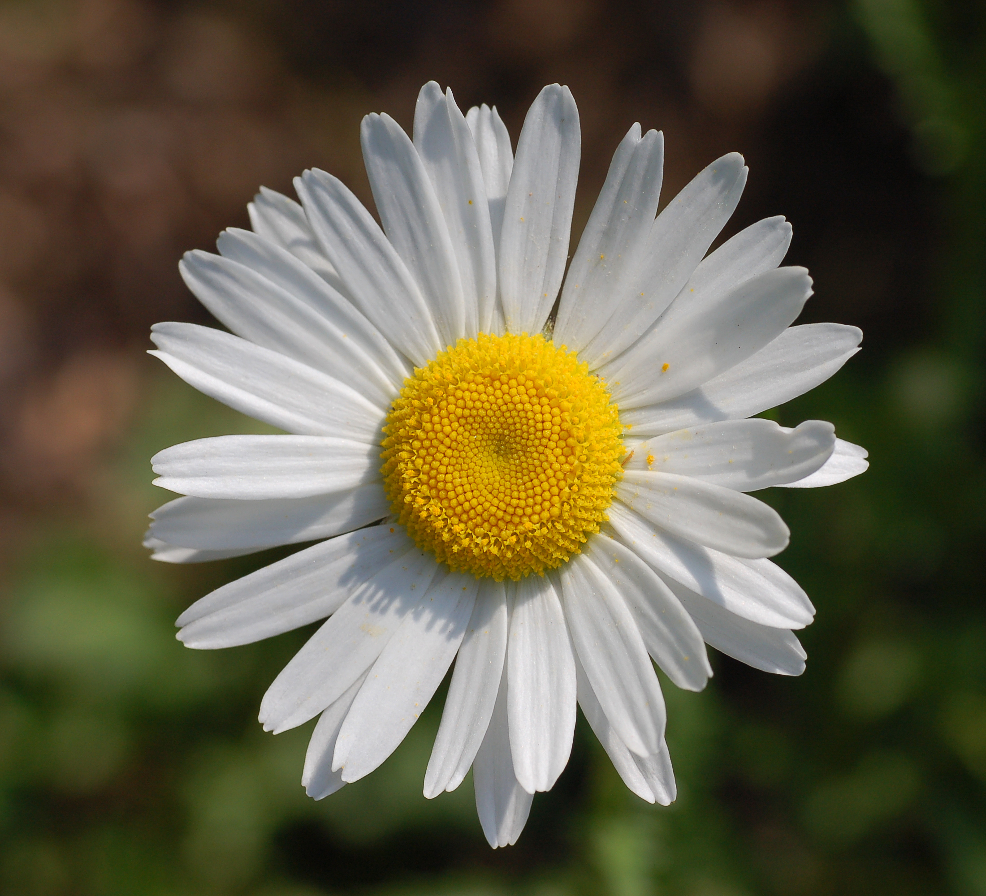
choose what you need

Slide 47
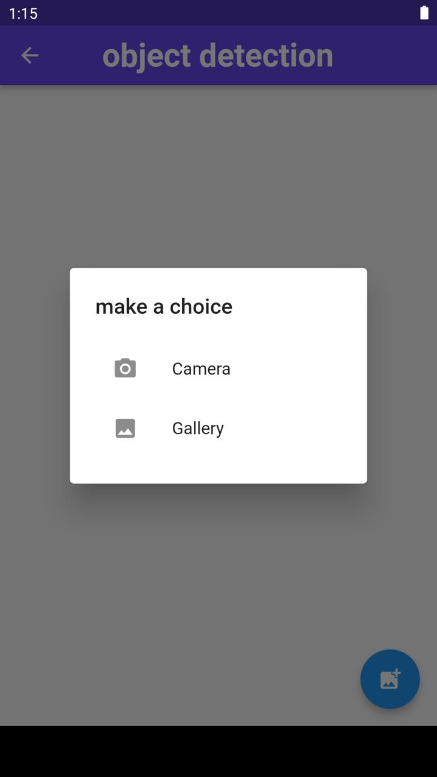
select one choice
object detection

Slide 48
select one choice
face detection
-add face
-detect face

Slide 49
select one choice
ocr

Slide 50
select one choice
coins

Slide 51
Demo

Slide 52
Future Work

Slide 53

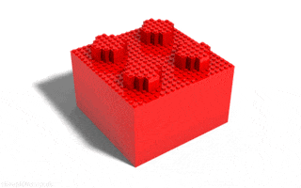


Future Work
1
4
Improve the quality
2
3
Add more images to our currency and increase number of epochs detection dataset to get better
accuracy.
. Make the response faster than it was by just using another Api
service
We can train our model on more objects than coco dataset trained YOLO model.

Slide 54
Thanks

